Slide 1
Everything EMRA
- Why it Matters -
Name of Meeting / Conference
Date of Presentation
Presented by
Emergency Medicine Residents’ Association
Notes:
Thank you for welcoming EMRA to your meeting today. My name is ___________ - I’m a (year) resident at (name of program).
I’m also a big fan of EMRA and have been for quite a while. Today I’d like to share why that’s so and why I think everyone in emergency medicine should join EMRA.
If you are already an EMRA member, maybe I can enlist your help in convincing those residents who aren’t members what a great organization this is! If you haven’t joined yet, I hope to show you the fabulous resources that EMRA offers to residents and convince you that being a member throughout your residency is a fabulous way to get involved in an organization that grows with you in your career.
Let’s get started! And if you have questions – please feel free to ask them at anytime – this is your meeting and I want to make sure you go home with your questions asked and answered. I will also leave you with my contact information at the end of my presentation today – I’m available anytime to answer your questions or help get them answered.

Slide 2
You’ve chosen Emergency Medicine.
You’re a Resident.
Now the Real Questions Begin!
I need educational resources.
I want to network – I want to be involved.
I need a job!
I don’t know what I need!
Notes:
So you’re a resident now! Let me tell you – it’s a fabulous and rewarding way to spend your time as a physician. But – be aware – throughout your residency, you will have so many questions, at times your head will spin! I know I did. Here are just a few of the hundreds of questions that will pop in your head!
PRESS ENTER OR THE DOWN BUTTON:
I need educational resources (there are never enough, right?). There are so many resources – what’s out there that you need RIGHT NOW for whatever year residency you’re in? EMRA helps guide you through the sea of information and has some valuable resources that are available to you at the right time. Not overwhelming, not so much that you get frustrated. We like to say we send you the “right dose of information at the right time.”
I want to network – I want to be involved with others in the specialty – but how do I get started and meet more people that just my colleagues at my program? There’s a way - EMRA has so many opportunities! Some members want a minimal amount of resources and contact and that’s okay. And some members want to be immersed in everything! We have lots of ways to become engaged – ways that are comfortable for you and your particular style. We’ll go over some of our most popular programs and events – and we’re going to have some fun doing it (you’ll find that FUN and LAUGHTER are important to EMRA’s members - life’s too short to take ourselves too seriously!).
I need a job! Even before you graduate from residency, you’re thinking about landing your next job, right? EMRA is thinking about that, too! You should know that EM Career Central is the easiest, most efficient way to start your job search. Have you ever been to a job search site and wondered if the job postings are real, actual jobs? At EM Career Central, a job is NOT posted unless it’s real. You search for your dream job (or your “dream-right-now job”) upload your resume, click to apply when you find something appealing - that’s it! You can even apply from your phone with one-click after you have completed your profile – what could be easier?
Need advice on getting through residency? Who doesn’t? It’s one of the scariest times for us – we’ve all gone through it and we know! We can’t take the stress out of being a resident but we can sure help smooth the waters as you’re going through it! Join us – become part of us – get to know us – you will have friends for life and people to call when things get stressful.

Slide 3
You Need EMRA!
- The Basics -
We are the voice of emergency physicians-in-training and the future of our specialty
Run by residents (and medical students)
for residents (and medical students)
Largest resident organization worldwide
Founded in 1974
12,000+ members and growing
Medical students, residents, alumni
Our membership is comprised of:
15% medical students
60% residents
25% alumni and fellows
Notes:
Okay – time to interrupt with a blatant commercial message! If you don’t know much about EMRA, here’s really what you need to know:
The thing that makes us so special, is that we are the ONLY resident organization that’s run by residents - for residents. That includes our entire board of directors - all thirteen members are either residents or medical students.
85% of our total membership is comprised of residents and alumni – you carry a lot of weight – your voice is critical. We work hard to make sure that you are heard and we bring you programs that are relevant to you.

Slide 4
If you’re not already a member, shouldn’t you be?
We welcome MD’s and DO’s
Join anytime during your residency – the sooner, the better, to reap great benefits!
Annual $105 membership provides benefits from three stellar emergency medicine organizations. Ask your program – they may pay for your membership!
EMRA (Emergency Medicine Residents’ Association)
ACEP (American College of Emergency Physicians)
Your State Chapter
Some chapters have additional dues
Benefits, oh … the benefits you’ll reap …
during residency and beyond
Notes:
So - why should you join EMRA? The answer is easy – when you join EMRA, you are also a member of ACEP and trust me, that is priceless! You’ll meet people during your residency who will be invaluable resources during your lifetime.
Why not meet those people early and form relationships now? Why wait? Where else can you meet the founder of your organization, the specialty’s legends, program directors and coordinators from across the country? You will indeed have a leg up when you join early!
And then – there are the tangible benefits - publications - discounts - networking opportunities - meetings and conferences - opportunities to get involved from the very get-go.
And the price is so very minimal for the benefits you receive – I’ll show you in a minute how the $105 annual membership pays for itself literally the minute you join! Note: some state chapters may have additional dues, so you will want to check that out.

Slide 5
You need help?
You need “resident-friends”!
You’ll find us at:
SAEM, Scientific Assembly/ACEP
ACEP Chapter Regional Meetings
EMRA Events – parties, SimWars, Quiz Shows, special get-togethers
AMSA, SNMA, AMA conferences
Find lifelong friends who have navigated stormy waters before you.
Do not attempt to sail through residency alone!
Have I made the
right decision?
I believe in
work-life balance. How do I make it happen?
What’s it really like
to be an EM doc?
How can I possibly find a job? When should I start looking?
Notes:
Nagging questions come up. EMRA residents have answers! Does this feel familiar?
Geez, I’m wondering about this decision – was it the right one?
How the heck does this work-life balance thing work – I got through medical school; I matched – now I’m just not sure how to get through this next phase?
How am I ever going to have time to search for a job?
A few minutes ago, I mentioned that, as a resident, you’re head will be spinning with questions – perfectly natural. Everyone I know who has traveled this path, at some time, had doubts and needed help.
PRESS ENTER OR THE DOWN BUTTON:
Go where residents are! There are so many meetings and conferences. When you are there – seek us out! EMRA members are everywhere and we love to talk about all things EM and all things E-M-R-A! Need help? Got questions? Want to get involved? Having a struggle with something? Have a great idea for the organization? We’re approachable and passionate about the organization and about our specialty. Lean on us – let us know what you’re thinking!

Slide 6
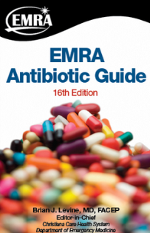
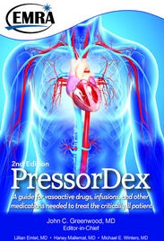
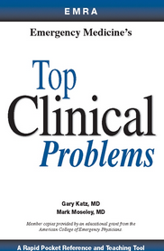
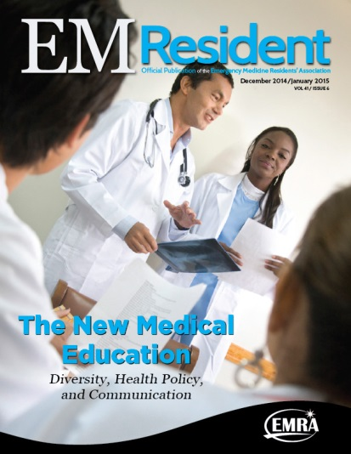
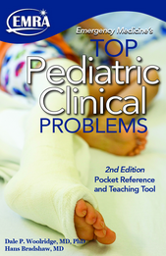
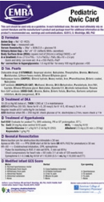
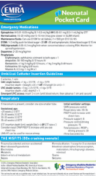
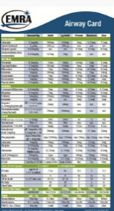
Over $100 worth of
EMRA Publications
Upon Joining!
You need educational resources?
You are at the right place.
Many Professional Benefits!
Complimentary
or
Deeply Discounted
Magazines
plus
Daily & Monthly
E-newsletters
For full list of benefits: www.emra.org/benefits/Membership-Benefits
Notes:
Going back to one of those initial questions residents have – what educational resources are available to me as an EMRA member?
EMRA has you covered! Upon joining, you will receive a complete membership kit, specially tailored for residents. In the kit, you’ll receive EMRA publications that total $106 in retail value – that already pays for your membership! You’ll find: three pocket reference cards – Pediatric Qwic Card; Neonatal Pocket Card and the Airway Card; Basics of EM: Pediatrics; Top Clinical Problems and Top Pediatric Clinical Problems; the two most popular EMRA Guidebooks - PresserDex and ABx Guide and a Research Handbook for Residents. Ask any EMRA member – residents use these guidebooks and reference cards constantly!
That just scratches the surface though. EMRA publishes EM Resident, a bi-monthly magazine with loads of clinical and lifestyle features and a monthly e-newsletter called What’s Up? in emergency medicine. The newsletter is delivered to your inbox and is always chockfull of easy-to-read news on upcoming events, benefits, clinical snapshots, and opportunities.
And don’t forget – when you are an EMRA member, you are also an ACEP member and receive their monthly newsletter, ACEP Now and daily e-newsletter called Emergency Medicine Today.
We don’t have time to go over all the benefits of an EMRA membership, but suffice it to say – with the EMRA and ACEP publications along with free or substantially discounted EM subscriptions, podcasts and video casts, you will not want for educational resources. And many of these benefits are absolutely free for residents!
It’s worth checking out at www.emra.org/benefits/Membership-Benefits/

Slide 7
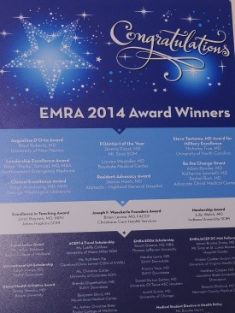
You want to network? Be involved?
EMRA has you covered!
WRITE | SERVE | LEAD | EARN
GET PUBLISHED! Submit an article to EMRA’s official magazine, EM Resident. Author an article for an EMRA publication. Contribute to EMRA’s monthly e-newsletter, What’s Up? in emergency medicine. | GET NOTICED! Join an EMRA Committee or Division. Be a decision maker! Implement EMRA’s objectives and goals. Follow your bliss: Awards Critical Care Editorial Education EMS Health Policy Informatics International Medicine Pediatric EM Research Simulation Ultrasound Wilderness Medicine | GET IN FRONT! Run for office. Serve on the EMRA Board of Directors. Positions available every year! Write a Resolution. Influence the direction of the organization. Participate in Representative Council meetings. | GET REWARDED! Over $70,000 of awards given annually to medical students and residents. Travel scholarships, local action grants and awards! Spring awards presented at SAEM; Fall awards presented at Scientific Assembly.
www.emra.org
Notes:
It doesn’t matter if you want to be “ a little involved’” or “a lot involved” – there is something at EMRA for everyone! Let me show you how.
Review the sections and the various ways to volunteer.
Now – think about looking for your first job out of residency. If you have been published - if you have served on an EMRA committee or division - if you have received an EMRA award – AND THAT’S ON YOUR CV – what does that say about you? You have a leg up on other applicants – that’s what it says about you! Believe me – program directors will notice that you have been involved!
I encourage you to find your niche – find your comfort level and get involved somehow!

Slide 8
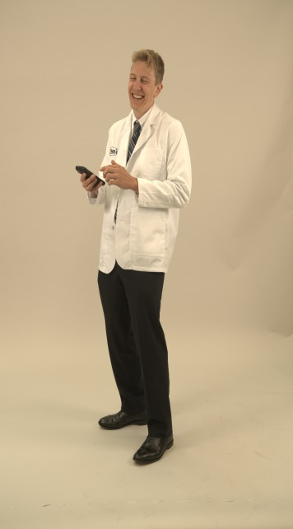
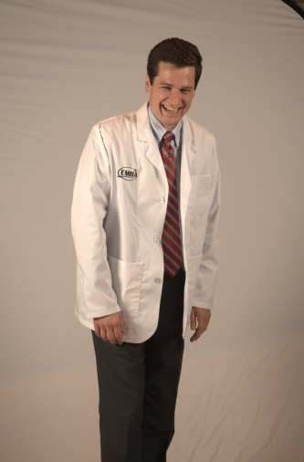
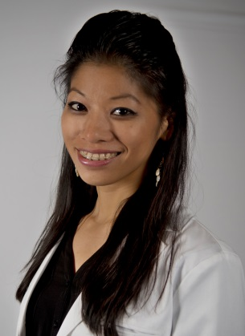
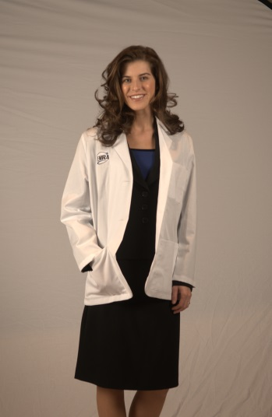
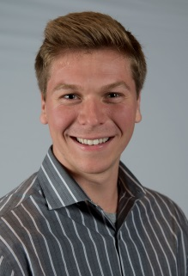
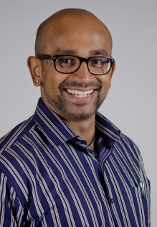
You don’t know what you need?
We think you need EMRA!
Join our family!
You are welcome here!
Join the
EMRA family!
You are welcome here!
Notes:
I hope you’re convinced that EMRA is the place to be – we work hard – we play hard – we really are one big happy family!
If time, ask the audience if they have questions. If not, GO TO CLOSING SLIDE

Slide 9
www.emra.org
Thank You!
Questions?
Presenter’s Name Here
Presenter’s Email Address Here
Notes:
EMRA is such a special place – I would love to welcome you into the organization – I guarantee you will find a home of like-minded, interesting and engaging people. Thank you for your time today – here’s my contact information in case you have questions, please don’t hesitate to contact me.

