Slide 1
Orthopedic Emergencies
Patrick Sinclair, D.O., EMT-B

Slide 2
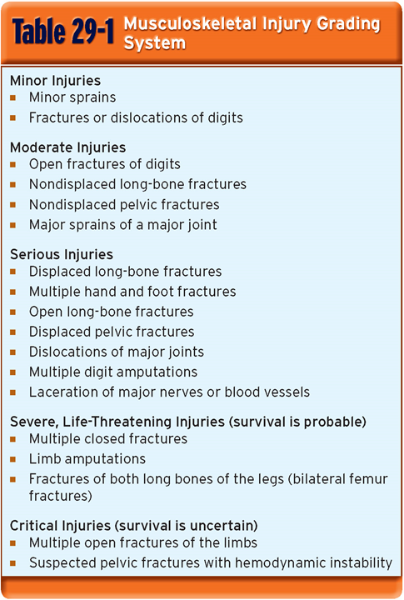
Overview
Sprains, strains, dislocations and fractures
“VONCHOP”
Vascular compromise
Open fracture
Neurologic deficit (cauda equina)
Compartment Syndrome
Hip dislocation
Osteomyelitis (septic arthritis)
Pelvic Fracture (unstable)

Slide 3
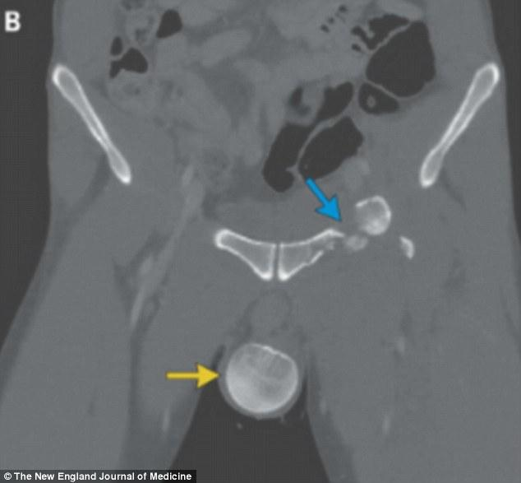
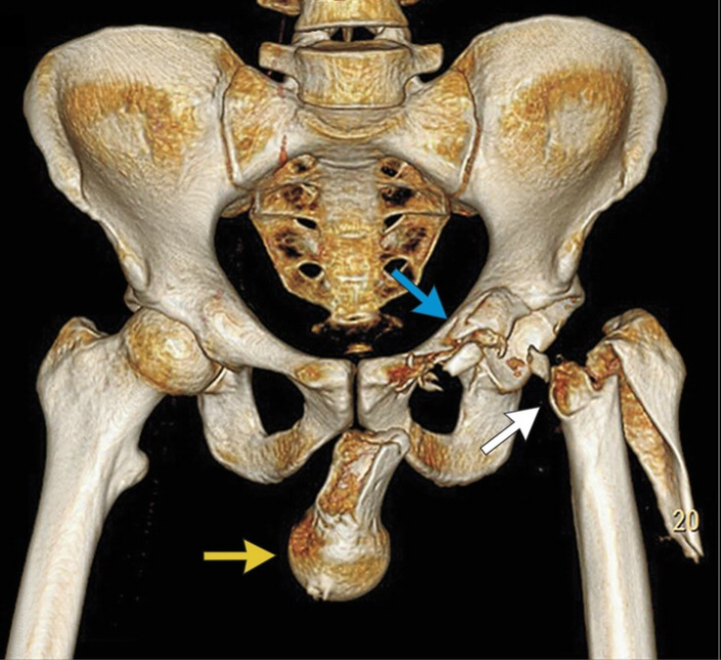
WTF?
A 33-year-old man was admitted to the emergency department after a motorcycle accident. Clinical examination of the intubated patient showed a hard, swollen, bluish scrotum and an externally rotated and slightly shortened left leg

Slide 4
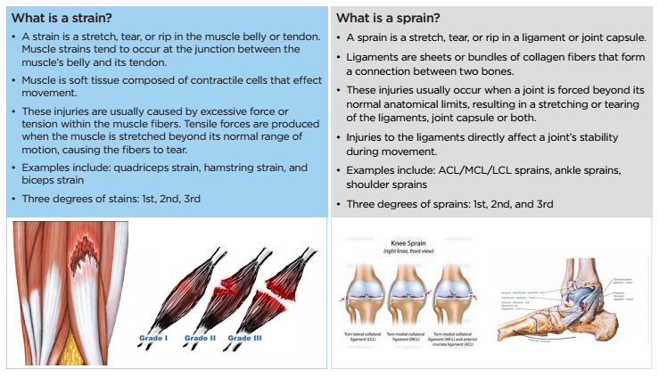
Strain vs. Sprain
Notes:
What is the big deal then? ------> we need to worry about underlying fracture and neurovascular compromise

Slide 5
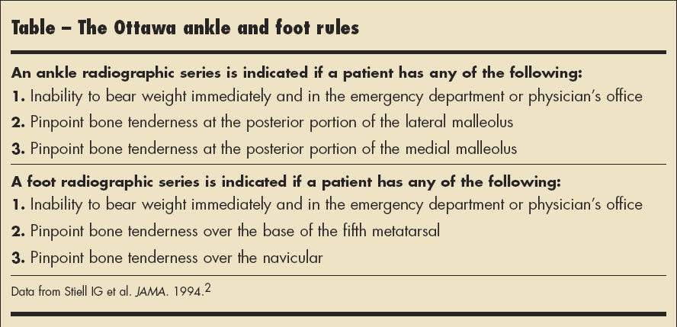
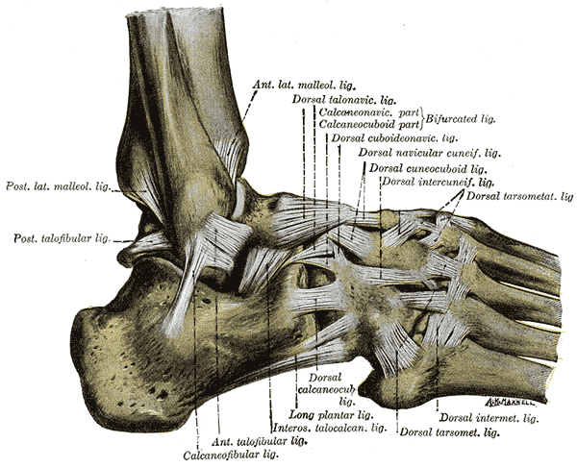
What Are We Getting At?

Slide 6
Fractures: The Main Points
Does one exist?
Where is it located along the bone? Proximal, mid, distal
Is it open or closed?
Signs of Fracture
Deformity False Motion
Tenderness Locked Joint
Guarding Pain
Swelling Exposed Fragments
Bruising
Crepitus

Slide 7
Fractures
•Greenstick
–An incomplete fracture that passes only partway through the shaft of a bone
•Comminuted
–A fracture in which the bone is broken into more than two fragments
•Pathologic
–A fracture of weakened or diseased bone

Slide 8
More Fractures
•Oblique
–A fracture in which the bone is broken at an angle across the bone
•Transverse
–A fracture that occurs straight across the bone

Slide 9
More Fractures
•Spiral: suspicion of abuse in pediatrics
–A fracture caused by a twisting force, causing an oblique fracture around the bone and through the bone
•Incomplete
–A fracture that does not run completely through the bone

Slide 10
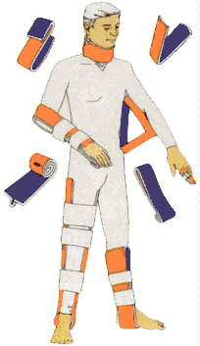
Splinting
you can use pretty much anything
you must immobilize the proximal and distal joint to effectively splint a fracture
alway check PMS before and after!

Slide 11
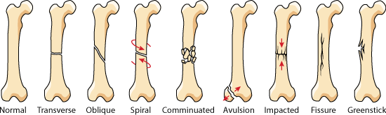
Visual Recap

Slide 12
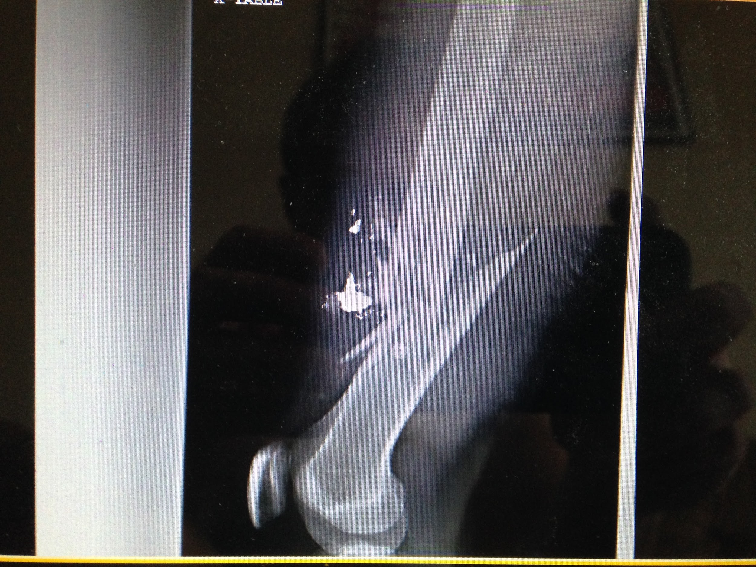

Slide 13
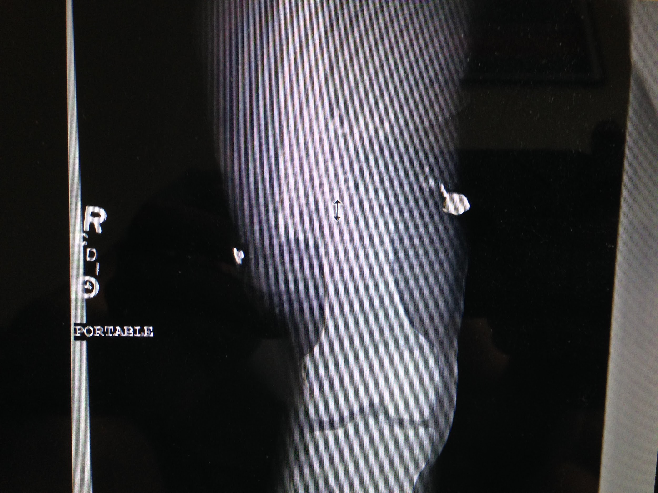

Slide 14
Dislocations
Separation of two bones where they meet at a joint
Shoulder, Elbow, Hip
what are we primarily concerned about with a joint dislocation?
Fracture and neurovascular compromise
Treatment: always immobilize the joint in the position of comfort
Pulse, Motor, Sensation!
Crepitus and Point Tenderness of bony prominences!

Slide 15
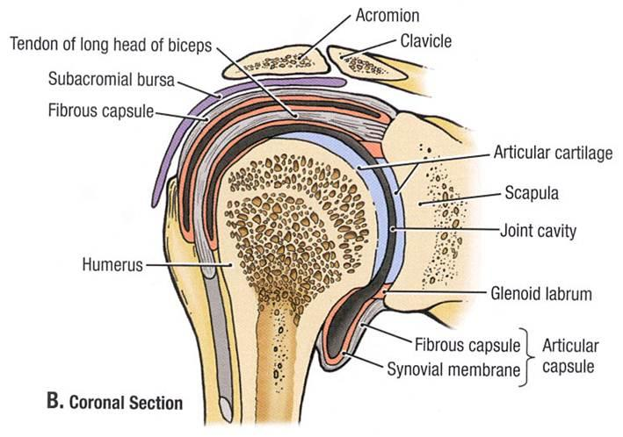
Shoulder
Anterior (90-98%): caused by a blow to the posterior shoulder or abduction + external rotation + extension injury, most commonly seen in trauma
Posterior (2-4%): direct blow from the anterior aspect of the shoulder or internal rotation + adduction + flexion injury, most commonly seen in seizures and electric shocks
Inferior (~0.5%): usually a hyperabduction force which levers the humeral neck against the acromion or high energy force from above, usually associated with soft tissue injury or fracture

Slide 16
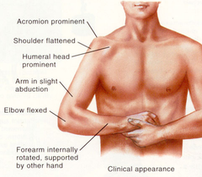
Anterior Dislocation Presentation

Slide 17
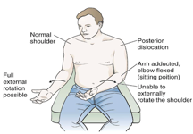
Posterior Dislocation Presentation

Slide 18
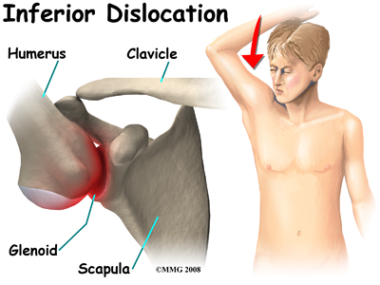
Inferior Dislocation Presentation

Slide 19
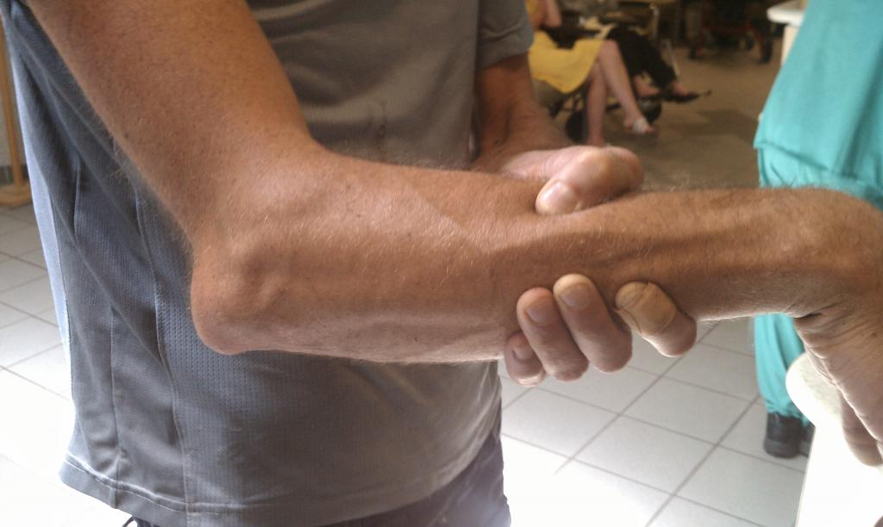
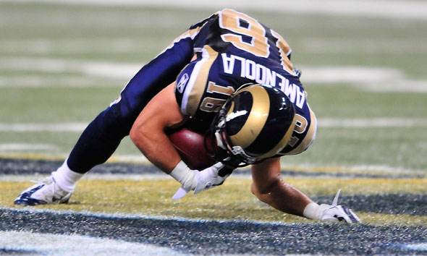
Elbow Dislocation
usually due to a FOOSH mechanism (Fallen On an OutStretched Hand)
most commonly posterolateral
Presentation: elbow held at 45 degrees of flexion

Slide 20
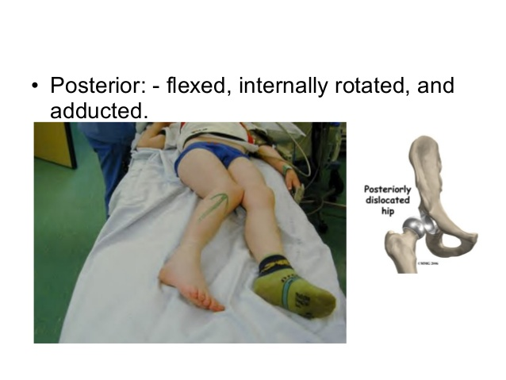
Hip Dislocation
most commonly posterior dislocations
often seen with knee-to-dashboard injuries
one of the orthopedic emergencies as this must be reduced within 6hrs → high risk of avascular necrosis
more likely to be seen in the setting of a hip replacement

Slide 21
Compartment Syndrome
an increase in the interstitial pressure over its capillary perfusion pressure due to the accumulation of necrotic debris and hemorrhage
Acute causes: tibial or forearm fractures, ischemic reperfusion following injury, hemorrhage, vascular puncture, IV drug injection, casts, prolonged limb compression, crush injuries and burns.
Chronic causes: exercise induced, usually not an emergency, goes away within 30 minutes of onset, but may lead to transient or permanent nerve damage, most commonly affects the anterior part of the leg (confused with shin splints)

Slide 22
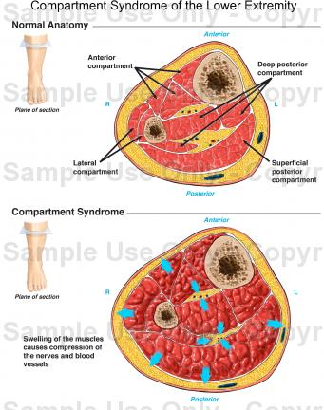
Compartment Syndrome
The 6P’s
Pain: out of proportion to clinical exam (most significant early sign)
Pressure: Tense Swelling (Early consistent finding)
Pain: With passive stretch
Paralysis: muscle weakness
Pulses: Present (Pale Toes)
Paresthesia: Sensory Deficit (Usually Late)

Slide 23
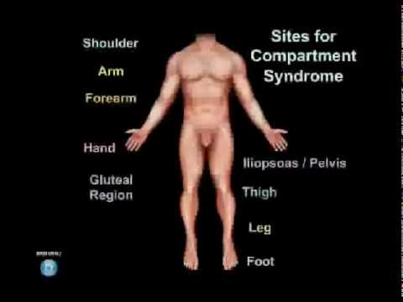
Where to Direct Your Trauma Assessment

Slide 24
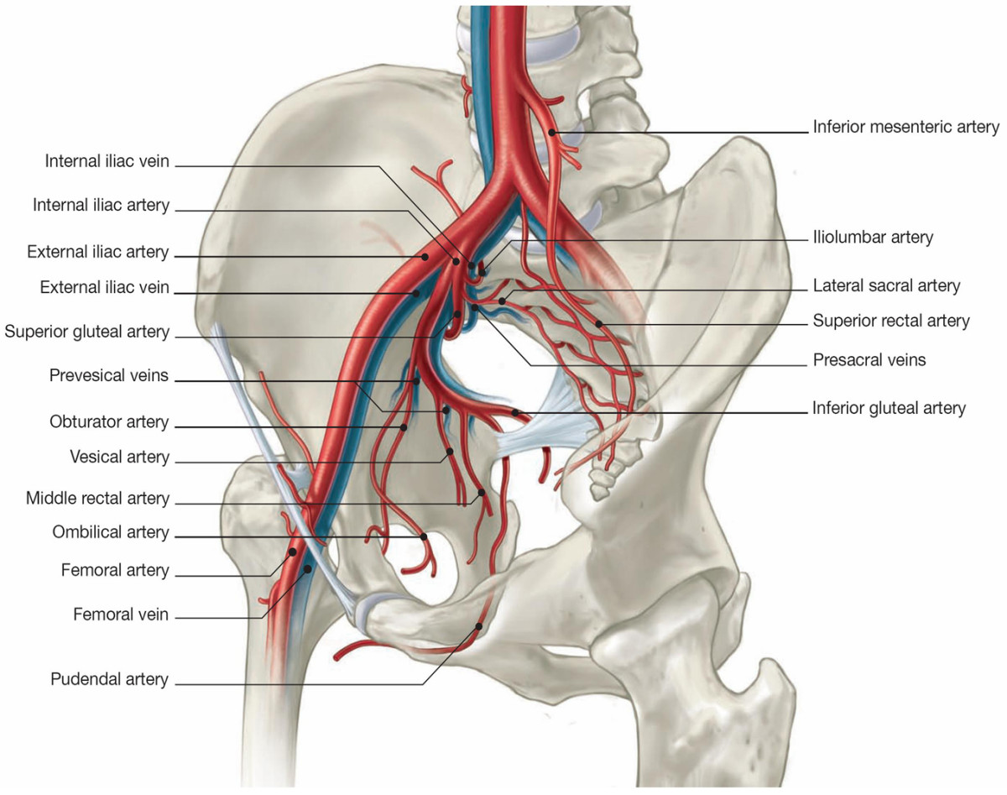
Why Pelvic Frx is So Concerning...
Usually takes a tremendous amount of force
The pelvis is highly vascularized
One of the places you can lose a lot of blood without any obvious signs
damage to the genitourinary system
Major Assessment and Treatment
make sure you “rock the pelvis” as part of your trauma assessment
Apply pelvic binder

Slide 25
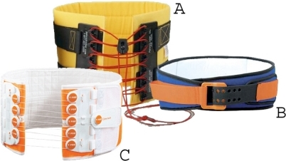
Pelvic Binder
In general, the literature demonstrates that in the hemodynamically stable, alert and oriented trauma patient with no distracting injury and no signs of pelvic fracture, pelvic stabilization is not required.
if any of these criteria fail to be met, or you have a high enough suspicion you must apply a binder

