Slide 1


mPOWEr: Piloting a Mobile Application for Wound Care Follow Up in the Emergency
Department
Molly L Tolins¹, MD; Sophie Morse¹; Daniel S Hippe², MS;
Marie C Vrablik¹, MD, MCR
¹Department of Emergency Medicine
²Department of Radiology
University of Washington, Seattle, WA

Slide 2
Disclosures
This project was supported by the University of Washington Department of Medicine Quality and Safety Accelerator Grant Program
mPOWEr was created and its modification for our study was supported by Dr. Heather Evans, Dr. Bill Lober, and their group at the University of Washington

Slide 3
Background
Many ED patients do not have primary care¹
7.3 million patients present annually for lacerations², and 3.5 million for soft tissue infections³
2.6% of lacerations become infected⁴
3.1% of patients with skin and soft tissue infections are admitted within 7 days related to inadequate follow-up⁵
Standard of care often includes follow-up with a primary care provider or return to the ED for a wound re-evaluation⁵
Notes:
It comes at no surprise to this audience, but many ED patients do not have primary care, And risk being lost to follow-up
Approximately 7.3 million ED visits are made to US emergency departments annually for lacerations between 1992 and 2002. 3.5 million visits for skin and soft tissue infections were made to EDs nationally in 2005, and vast majority discharge home
In a large prospective multi­center ED study, 2.6% of traumatic lacerations became infected, while another study showed up to 26% of patients had treatment failure within 7 days after an abscess incision and drainage (I&D).
In one retrospective cohort study of patients discharged from EDs with diagnoses of skin and subcutaneous infections, 3.1% were admitted within 7 days, related to inadequate follow­up.
We all know that follow-up with PCP is not often possible

Slide 4
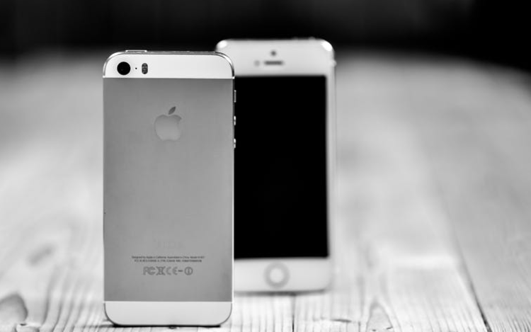
Background
91.2% of a random cross-sectional survey of ED patients had computer access, and 95% used mobile phones⁶
Previous studies have shown interest, but found 0% compliance in technology-based wound care follow-up in an ED population⁷
In surgical populations, technology-based follow-up has had good results^{8,9}
Notes:
…both for patients seeking greater accessibility to health care and surgeons facing increasing time constraints
6. Ranney M, Choo E, Wang Y, Baum A, Clark M, Mello M. Emergency department patients’ preferences for technologybased behavioral interventions. American College of Emergency Physicians, 2012. doi:10.1016/j.annemergmed.2012.02.026.
7.Walker TW, O'Connor N, Byrne S, McCann PJ, Kerin MJ. Electronic followup of facial lacerations in the emergency department. J Telemed Telecare. 2011;17(3):1336. doi: 10.1258/jtt.2010.100307. Epub 2011 Jan 26. PMID: 21270048
8.Broman K, Oyefule O, Phillips S, Baucom R, Holzman M, Sharp K, Pierce R, Nealon W, Poulose B. Postoperative Care Using a Secure Online Patient Portal: Changing the (Inter)Face of General Surgery. Journal of the American College of Surgeons. 2015; 221(6): 10571066.
9. Quinn EM , Corrigan MA , O'Mullane J , Murphy D , Lehane EA , LeahyWarren P , Coffey A , McCluskey P , Redmond HP , Fulton GJ . Clinical unity and community empowerment: the use of smartphone technology to empower community management of chronic venous ulcers through the support of a tertiary unit. . PLoS One. 2013 Nov 12;8(11):e78786. doi: 10.1371/journal.pone.0078786. ECollection 2013.

Slide 5
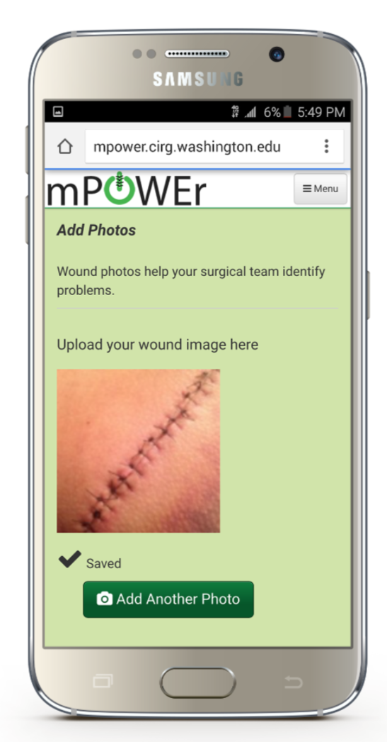
Background
mPOWEr (Mobile Post-operative Wound Evaluator), is an application developed for surgical clinics
It can be accessed via a secure password-protected portal by patients and designated providers
Notes:
…and adapted to our ED population for this project
...to review text-based symptoms and wound photographs submitted by patients
…as you can see, it has the look and feel of an app…

Slide 6
Objectives
Assess the feasibility of using an application, mPOWEr, for electronic follow-up in addition to standard of care among patients undergoing wound care
- Interest and participation rates
- Frequency of communication
Describe patient satisfaction

Slide 7
Methods
English-speaking patients with access to a smartphone undergoing laceration repair or I&D of abscesses at 2 urban EDs
Subjects asked to submit photos of their wounds on Days 1, 3, 7, and 14
On day 14 they received a survey, the Client Satisfaction Questionnaire (CSQ-8)
Patient participation assessed by percentage of consented participants that sent at least one picture via mPOWEr after wound care in the ED
mPOWEr text-communications, texts, and emails also considered
Notes:
2 urban Eds: 1 level 1 trauma center and one university medical center
...with reminder emails
…Client Satisfaction Questionnaire (CSQ-8), a validated and standardized measure of patient satisfaction

Slide 8
Results - Demographics
Variable | Value
Female sex | 25%
Age, years | 41 ± 16
Race
White | 82%
Black/African American | 11%
Other | 7%
Sites
Level 1 trauma center | 59%
University medical center | 41%
237 Approached
67 with no smartphone
170 w/ Smartphone
70 declined to enroll
100 Enrolled
No difference between enrolled and declined in sex, age, site, or race (all p ≥ 0.42)
Notes:
Enrollment period: Febuary – October 2017
67 (28%) of initial 237
100 (59%) of eligible patients were interested and enrolled in the study
Overall age range was 18-92 w/ standard deviation 16 years

Slide 9
Results - Demographics
Patients without a smart phone (vs. patients with)
More likely to be older (mean: 48 vs. 41 years, p=0.003)
Less likely to be white (62% vs. 78%, p=0.034)
Patients at the level 1 trauma center site (vs. university medical center)
Less likely to have a smartphone (66% vs. 84%, p=0.003)
Less likely to be female (20% vs. 35%, p=0.016)
No other significant differences in demographics
Notes:
We compared those patients with a smart phone to those without
Patients at the level 1 trauma center were Less likely to have a smartphone, with 66% of the subjects approached at the community site having smartphones vs. 84% at the academic medical center, and this was significant. They were also less likely to be female (20 vs. 35%)

Slide 10
Results – Participation*
57% of participants submitted a photo
60% communicated via mPOWEr (text-based symptoms OR photo) at any time
66% communicated via mPOWEr OR text/email at any time
None of these differed by site, sex, or age (all p≥0.14)
Median number of photos per subject who submitted any photos was 3 (range 1-17)
*N=95
Notes:
At the time of creating this presentation, 95/100 patients had completed full follow-up period and so our sample size for data analysis at this time is 95. Of these, …

Slide 11
Results
14% of subjects submitted photos at each time point
Any Photos
Notes:
45% on days 1-2
42% on days 3-6
35% on days 7-13
21% ond ays 14-19
14% submitted photos during all 4 periods

Slide 12
Results
26% vs 4% submitted photos during all 4 periods (p=0.002)
*
*
*p<0.05
Notes:
50% vs. 42% on days 1-2
48% vs. 38% on days 3-6
50% vs. 23% on days 7-13
33% vs. 11% ond ays 14-19
26% of those greater than or equal to 40 vs 4% of those less than 40 submitted photos during all 4 periods (p=0.002)

Slide 13
Results – Satisfaction Survey
N=21
Notes:
1=poor, 2=fair, 3=good, 4=excellent
21/95 (22%) have completed satisfaction surveys
71% would recommend this phone-based communication to a friend in a similar situation (Good or Excellent)
67% said that this phone-based communication would help them deal more effectively with their follow-up in the future

Slide 14
Conclusion
Our results suggest that this technology-based approach for wound care follow-up is feasible and patients are satisfied with the platform
This platform holds potential to increase safe discharge plans for an at-risk population

Slide 15
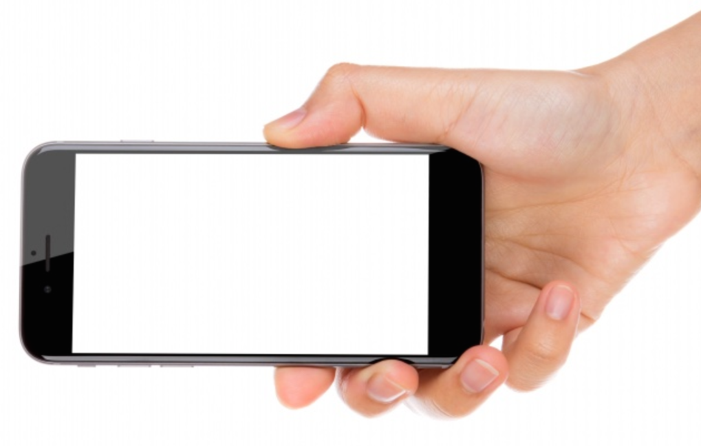
Questions?
Suggestions?

Slide 16
Cited Works
Babcock Irvin C, Wyer PC, Gerson LW. Preventive care in the emergency department, part II: clinical preventive services—an emergency medicine evidence based review. Society for Academic Emergency Medicine Public Health and Education Task Force Preventive Services Work Group. Acad Emerg Med. 2000;7:10421054.
Singer AJ , Thode HC Jr , Hollander JE . National trends in ED lacerations between 1992 and 2002. Am J Emerg Med. 2006 Mar;24(2):1838.
Pallin DJ, Egan DJ, Pelletier AJ, Espinola JA, Hooper DC, Camargo CA Jr. Increased US emergency department visits for skin and soft tissue infections, and changes in antibiotic choices, during the emergence of community­associated methicillin­resistant Staphylococcus aureus. Ann Emerg Med. 2008 Mar;51(3):291­8. doi: 10.1016/j.annemergmed.2007.12.004. Epub 2008 Jan 28.
Quinn JV, Polevoi SK, Kohn MA. Traumatic lacerations: what are the risks for infection and has the `golden period' of laceration care disappeared? Emerg Med J. 2014 Feb; 31(2): 96–100. Published online 2013 Jan 12. doi: 10.1136/emermed2012202143
Gabayan GZ, Asch SM, Hsia RY, Zingmond D, Liang LJ, Han W, McCreath H, Weiss RE, and Sun BC. Factors Associated with Short Term Bounceback Admissions Following Emergency Department Discharge. Ann Emerg Med. Author manuscript; available in PMC 2013 Aug 1.
Ranney M, Choo E, Wang Y, Baum A, Clark M, Mello M. Emergency department patients’ preferences for technology based behavioral interventions. American College of Emergency Physicians, 2012. doi:10.1016/j.annemergmed.2012.02.026.
Walker TW, O'Connor N, Byrne S, McCann PJ, Kerin MJ. Electronic followup of facial lacerations in the emergency department. J Telemed Telecare. 2011;17(3):1336. doi: 10.1258/jtt.2010.100307. Epub 2011 Jan 26. PMID: 21270048
Broman K, Oyefule O, Phillips S, Baucom R, Holzman M, Sharp K, Pierce R, Nealon W, Poulose B. Postoperative Care Using a Secure Online Patient Portal: Changing the (Inter)Face of General Surgery. Journal of the American College of Surgeons. 2015; 221(6): 10571066.
Quinn EM , Corrigan MA , O'Mullane J , Murphy D , Lehane EA , LeahyWarren P , Coffey A , McCluskey P , Redmond HP , Fulton GJ . Clinical unity and community empowerment: the use of smartphone technology to empower community management of chronic venous ulcers through the support of a tertiary unit. . PLoS One. 2013 Nov 12;8(11):e78786. doi: 10.1371/journal.pone.0078786. ECollection 2013.

